Slide 1
Employee Data Analysis using Excel
STUDENT NAME : Sriram.Y
REGISTER NO : 122201633
DEPARTMENT : B.Com Corporate Secretaryship
COLLEGE : SIR THEAGARAYA COLLEGE

Slide 2
PROJECT TITLE
Employee Performance Analysis using Excel

Slide 3


AGENDA
Problem Statement
Project Overview
End Users
Our Solution and Proposition
Dataset Description
Modelling Approach
Results and Discussion
Conclusion
3/21/2024 Annual Review

Slide 4

PROBLEM STATEMENT
Be Specific and Clear: - Identify the Issue: Clearly define the specific problem with
the current performance analysis process. For example, "The current performance evaluation system fails to accurately capture employee productivity and growth potential.“
Contextualize the Problem: - Background Information: Provide context about the organization's current situation, including existing methods for performance evaluation. - Why It Matters: Explain the significance of the issue. How does it impact the organization? For instance, "This gap in accurate performance analysis leads to ineffective training programs and misaligned goals.

Slide 5

PROJECT OVERVIEW
Project Objectives:- Develop a Comprehensive Performance Framework:
Design and implement a robust performance evaluation system that integrates quantitative
metrics (e.g., KPIs, productivity data) with qualitative inputs (e.g., peer reviews, self-assessments).-
Improve Accuracy of Performance Insights: Utilize advanced data analytics to accurately assess
employee performance, identify high and low performers, and understand the factors influencing
performance variations.- Align Employee Development with Organizational Goals:Use the insights
gained to tailor employee training and development programs, ensuring they are aligned with both
individual career paths and the organization's strategic objectives.-
Enhance Employee Engagement and Retention: Provide meaningful and timely feedback to
employees to boost morale, engagement, and reduce turnover rates.

Slide 6

WHO ARE THE END USERS?
Human Resources (HR): Uses the analysis for talent management, promotions,
and identifying training needs.
Managers and Team Leaders: Leverage the data to provide feedback, improve team performance,
and manage goal achievement.
Executives and Senior Leadership: Focus on aligning employee performance with organizational
goals and making strategic decisions.
Employees: Utilize performance analysis to understand their strengths, receive feedback, and
set personal development goals.

Slide 7

OUR SOLUTION AND ITS VALUE PROPOSITION
Conditional Formatting: Missing
Filter: Remove
Formula : Performance
Pivot: Summary
Graph: Data visualization

Slide 8
Dataset Description
Employee - Kaggle
26 - Features
9 - Features
Emp Id - Num
Name -Text
Emp - Type
Performance - Level
Gender - Male Female
Employee Rating - Num

Slide 9

THE "WOW" IN OUR SOLUTION
Performance Level = IFS(Z8>=5,”VERYHIGH”,Z8>=4,
“high”, Z8>=3, “MED”,TRUE,”LOW”)
3/21/2024 Annual Review

Slide 10
MODELLING
Data Collection :
Start Date
Exit Date
Performance Level :
High
Low
Very High
Data Collection :
Full- Time
Contract
Part – Time
Temporary

Slide 11
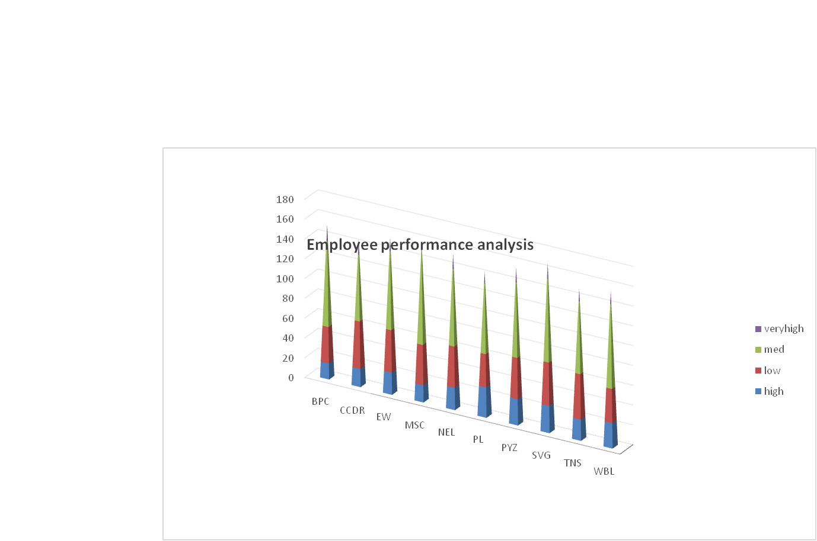
RESULTS

Slide 12
conclusion
Employee performance analysis is a vital tool for driving organizational success by aligning
individual efforts with broader business goals. It enables informed decision-making across
various departments, from HR to senior leadership, by providing insights into productivity,
skill gaps, and areas for improvement. Through regular and thoughtful analysis, organizations
can foster a culture of continuous improvement, ensuring that employees receive the support
and feedback needed to grow. Additionally, performance data helps in identifying top performers
and underperformers, facilitating fair compensation and career development. Ultimately, employee
performance analysis contributes to a motivated, well-managed workforce, enhancing overall business
performance.

